Slide 1

The Scrum-agile Approach Final Project
Madison Lopert

Slide 2


Roles and Responsibilities
Product Owner
Provides direction to the team on what will be built
Creates and prioritizes the backlog
Meets with the client and customers to gather feedback and requirements
Scrum Master
Facilitates at Scrum events including sprint planning, daily Scrum, sprint retrospective, and sprint review
Helps aid the team during challenges and roadblocks
Ensures effective backlog management
Developer
Designs and develops code
Follows standard software engineering practices
Utilizes user stories as guidelines for development
Communicates with peers to establish a full understanding of the requirements.
Tester
Defines acceptance criteria and create test-cases
Clarifies any defects found in the code or user stories to the team
Executes tests and analyzes results

Slide 3

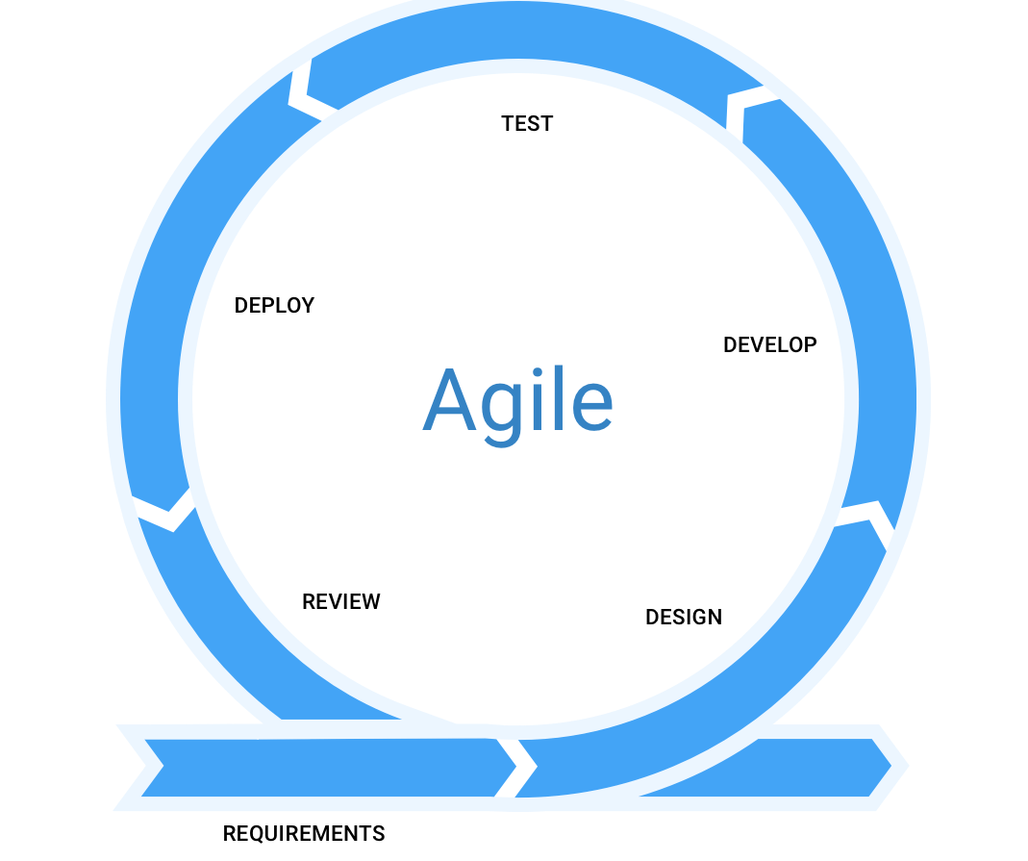
AGILE SDLC MODEL
Test
Deploy
Develop
Requirements
Design

Slide 4

AGILE IN SDLC
The Software Development Lifecycle (SDLC) is a process used to design, develop, and test software. There are various SDLC models but in this course, we are primarily focused on the Agile Model. This model consists of five different stages requirements, design, develop, test, and deploy. Agile is a combination of iterative and incremental process models. Agile breaks the product into small incremental builds and the builds are provided in iterations. In an agile model, the cycle will repeat.
Requirements | Design | Develop | Test | Deploy
This is the stage where the clients are met. Requirements are gathered and used to create the product backlog. | The stories and plans for execution are decided among the team through discussions in sprint planning sessions. | Once user stories are created and assigned, developers can view the details provided and start coding. | Testers on the team will test the user stories to verify they meet the acceptance criteria and meet the user’s needs. | Once the product has been developed and tested it can be placed into production and go-live to the client.

Slide 5
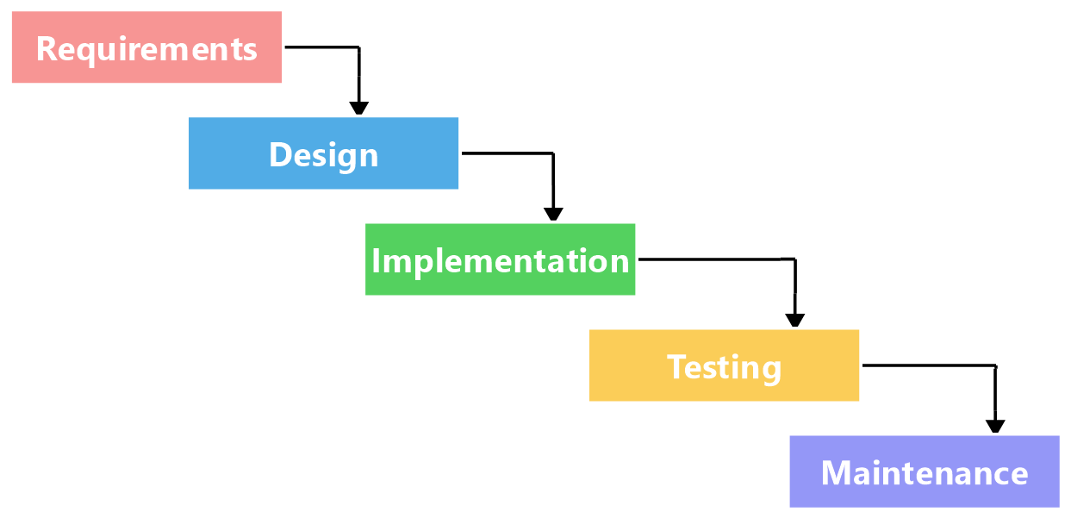
AGILE VS WATERFALL
VS

Slide 6
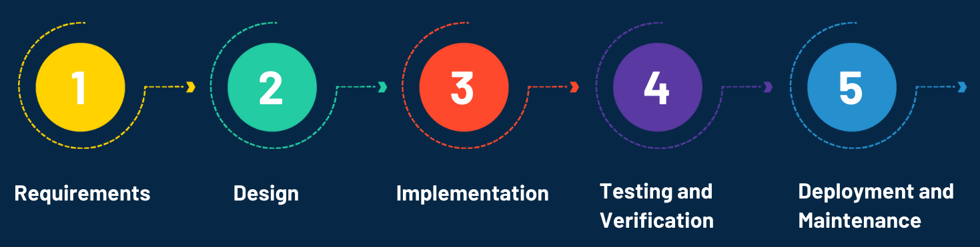
AGILE VS WATERFALL
The waterfall method was the first widely used SDLC model in software development. While the phases themselves are like the agile model with requirements, design, implementation (development), testing, and deployment there are significant differences between the two. Waterfall operates in a rigid sequential process. Each stage is completed one by one and nothing is ever repeated. In an agile process, the cycle repeats multiple times to allow for the client to introduce new changes and wants throughout the project. Agile is much more flexible for that reason. While agile and its many methodologies, such as Scrum, are becoming more popular over time, waterfall remains a highly used and practiced model in most software environments. The estimate as provided in the report “Success Rates Rise” by the Project Management Institute is 51%.

Slide 7

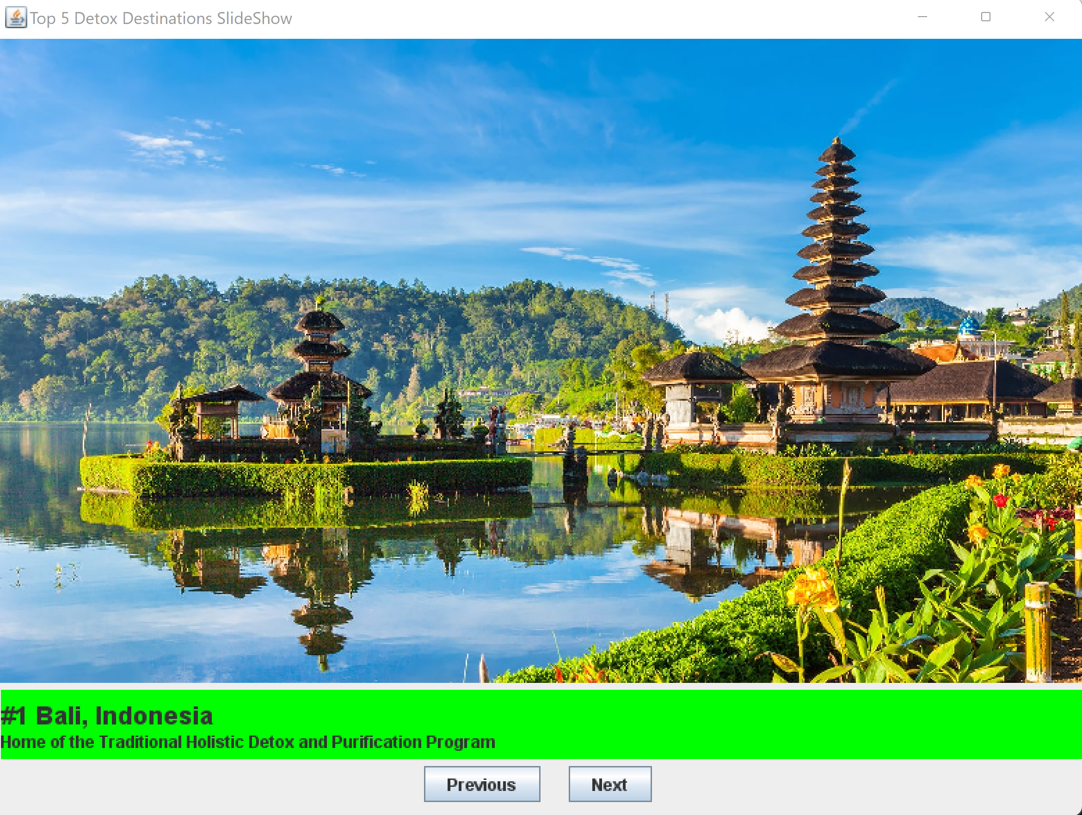
AGILE VS WATERFALL
Looking at the experience we had working on the SNHU Travel project, the development wouldn’t have gone the same if we followed the waterfall method. We had made the development for the top five destinations list slideshow based on requirements received early in the project. This went well, but later we received news from the SNHU Travel Management team that they wanted the focus of the project to focus on detox/wellness vacations. This was a decision they chose based on an industry report that stated detox/wellness vacations were going to be the next big travel sector. Agile is flexible enough to allow that change to happen but in waterfall, we would already have gone through the development stage. There would be no going back and instead, that new requirement would have to be discarded and what had already been developed would be pushed to deployment. This could risk the product not meeting the client’s standards and they might not receive as much value from the product as they could.
BEFORE
AFTER

Slide 8
FACTORS TO CONSIDER
Both waterfall and agile have their own benefits when properly utilized. Depending on the size, requirements, and expectations of a project either model could be a potential candidate for use. Throughout my experience working on the SNHU Travel project their risk of change, lack of documentation, and want to move towards a new niche (trendy vacation packages) are all signs to point towards utilizing the agile method. Below are some of the factors that each model is better equipped for.
WATERFALL
AGILE
Better for smaller projects
Requirements are well understood
Customer is clear on their intent and wants
Better for projects with a risk of change
Documentation is minimally required
Customer is unclear on their exact wants and needs

Slide 9
REFERENCES
SDLC - Agile Model. Tutorials Point. (n.d.). Retrieved October 16, 2022, from https://www.tutorialspoint.com/sdlc/sdlc_agile_model.htm
SDLC - Waterfall Model. Tutorials Point. (n.d.). Retrieved October 16, 2022, from https://www.tutorialspoint.com/sdlc/sdlc_waterfall_model.htm
SNHU Media. CS250-module five: Product owner and Scrum-Agile Team. (n.d.). Retrieved October 16, 2022, from http://snhu-media.snhu.edu/files/course_repository/undergraduate/cs/cs250/storyline/mod5/story_html5.html
SNHU Media. CS250-module three: Product owner and User Focus Group. (n.d.). Retrieved October 16, 2022, from http://snhu-media.snhu.edu/files/course_repository/undergraduate/cs/cs250/storyline/mod3/story_html5.html
SNHU Media. CS250-module two: Initial client meeting. (n.d.). Retrieved October 16, 2022, from http://snhu-media.snhu.edu/files/course_repository/undergraduate/cs/cs250/storyline/mod2/story_html5.html
Success rates rise - project management institute. (n.d.). Retrieved October 16, 2022, from https://www.pmi.org/-/media/pmi/documents/public/pdf/learning/thought-leadership/pulse/pulse-of-the-profession-2017.pdf?sc_lang_temp=en

Slide 10
Thank you!

